Slide 1
Detection of Phishing Websites

Slide 2
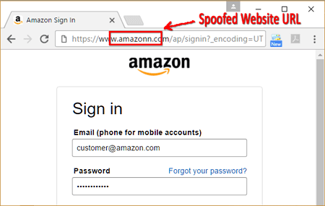
What is a Phishing Website?

Slide 3
What to look for in a phishing website?
Poor resolution. Phishing websites are often poor in quality, since they are created with urgency and have a short lifespan. If the resolution on a logo or in text strikes you as poor, be suspicious.
Forged URL.
fake names,

Slide 4
Ways to detect Phishing Website:
1. Check the URL. Example -www.yah00.com
2. Assess the content within a site.
3. Check who owns the website.
4. Read online reviews.
5. Trusted payment methods.

Slide 5
Features required for detection
Long URL to Hide the Suspicious Part,Using URL Shortening Services “TinyURL”,
URL’s having “@” Symbol, Redirecting using “//”, Sub Domain and Multi Sub Domains,
HTTPS (Hyper Text Transfer Protocol with Secure Sockets Layer), Domain Registration Length ,
The Existence of “HTTPS” Token in the Domain Part of the URL,
Using the IP Address,Number of Links Pointing to Page ,
Statistical-Reports Based Feature,Submitting Information to Email, Abnormal URL, Website Forwarding, Status Bar Customization,Disabling Right Click , Using Pop-up Windo, IFrame Redirection,
Age of Domain, DNS Record,Website Traffic, PageRank, Google Index

Slide 6
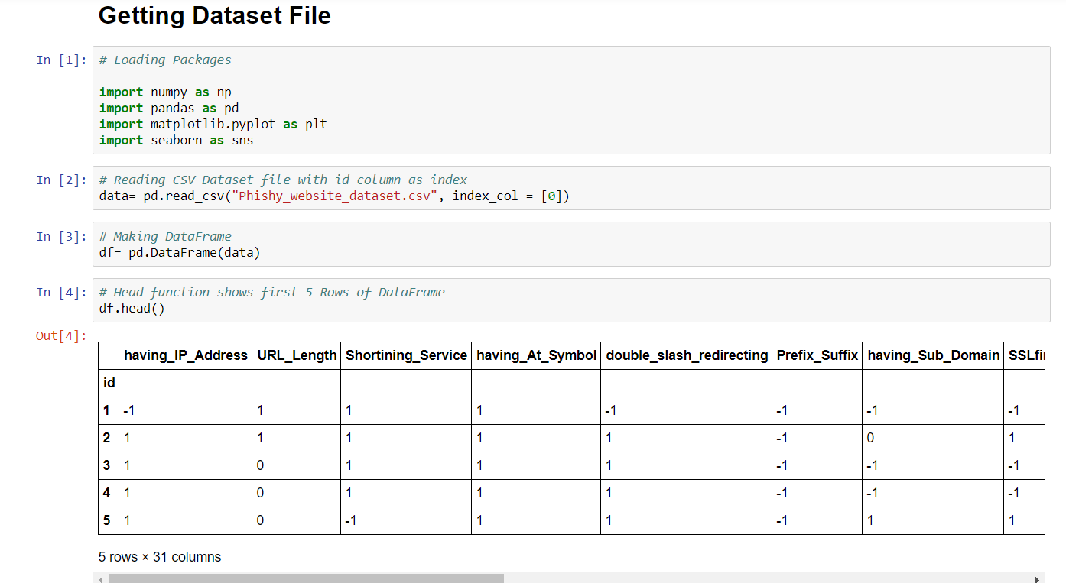

Slide 7
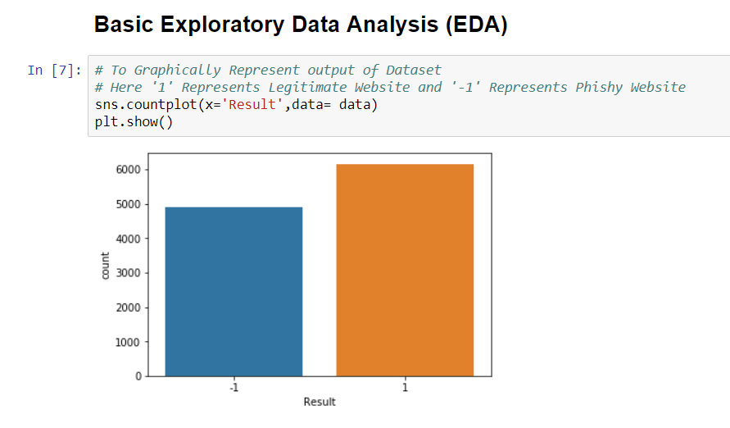
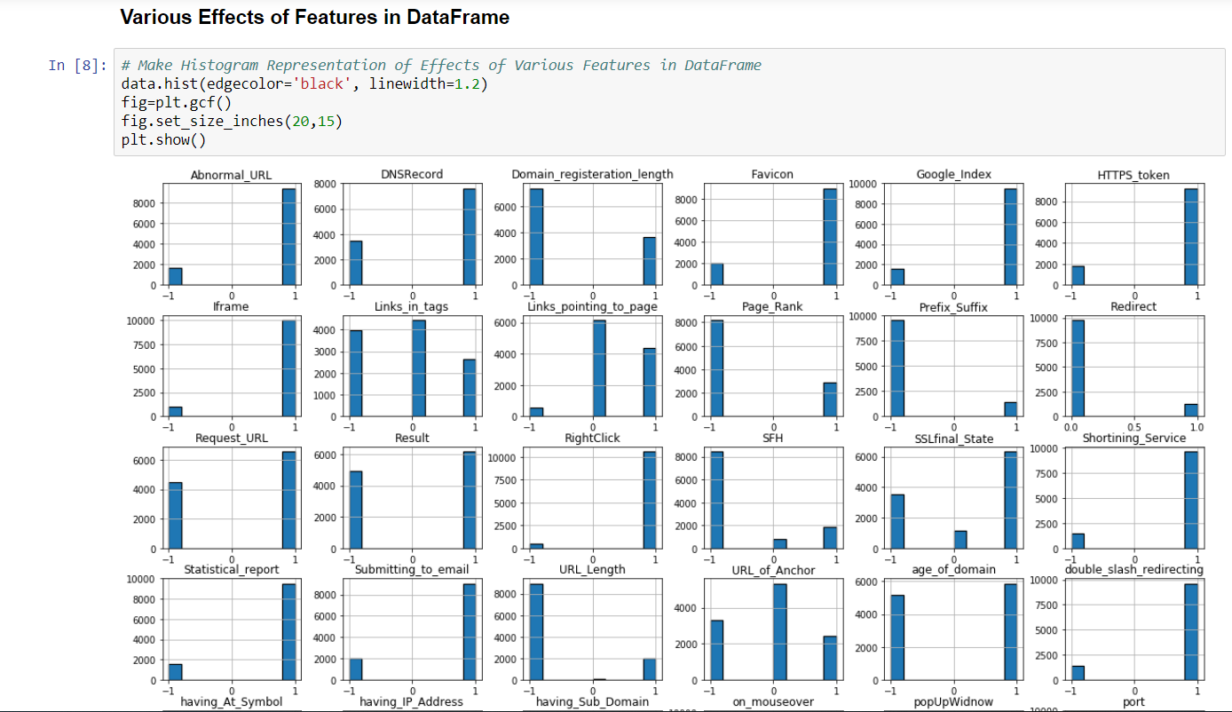

Slide 8
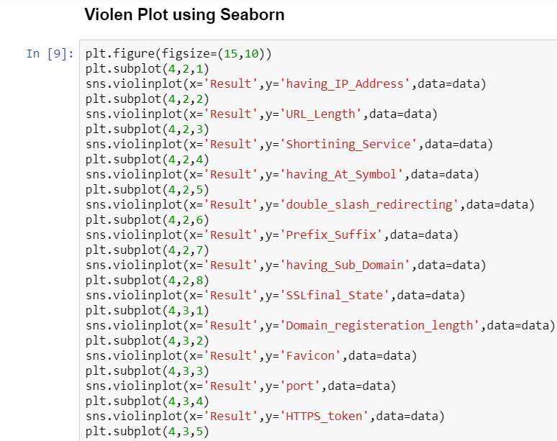
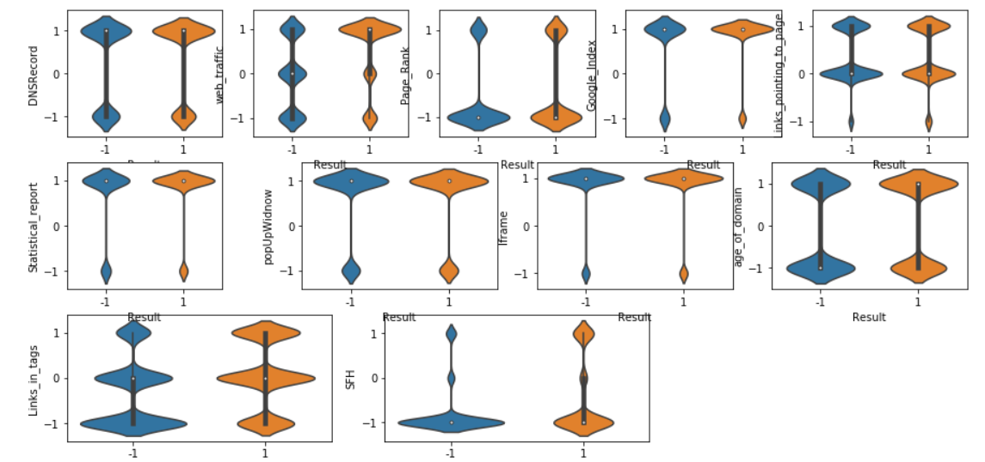

Slide 9
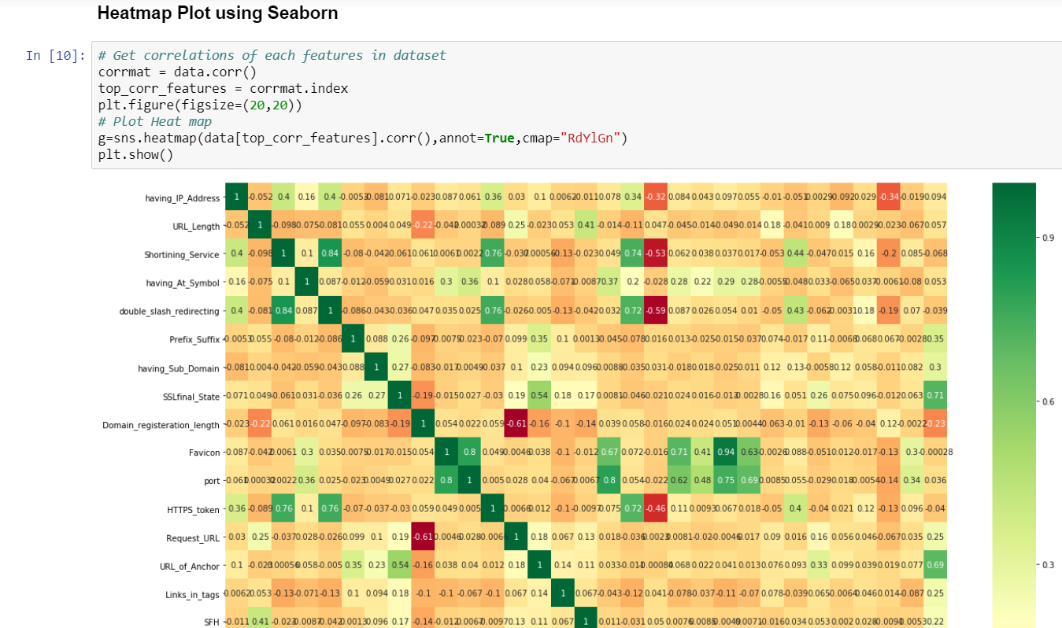

Slide 10
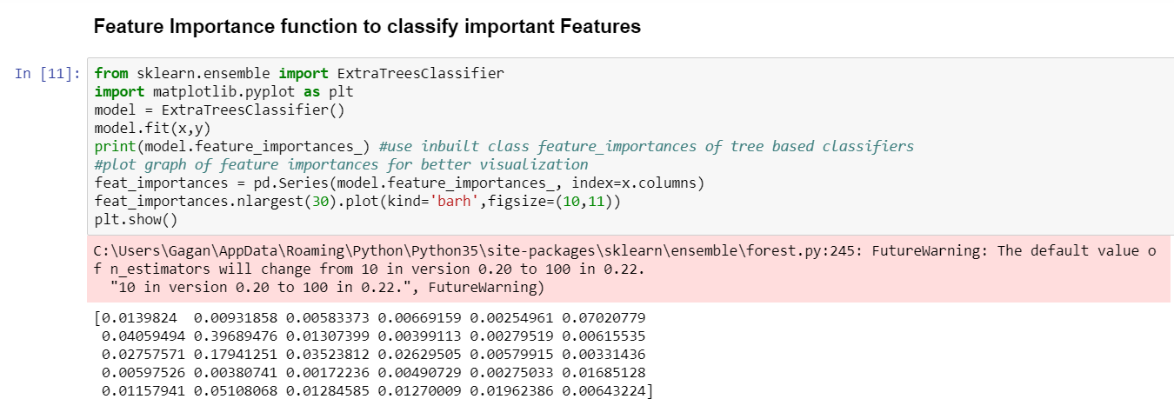
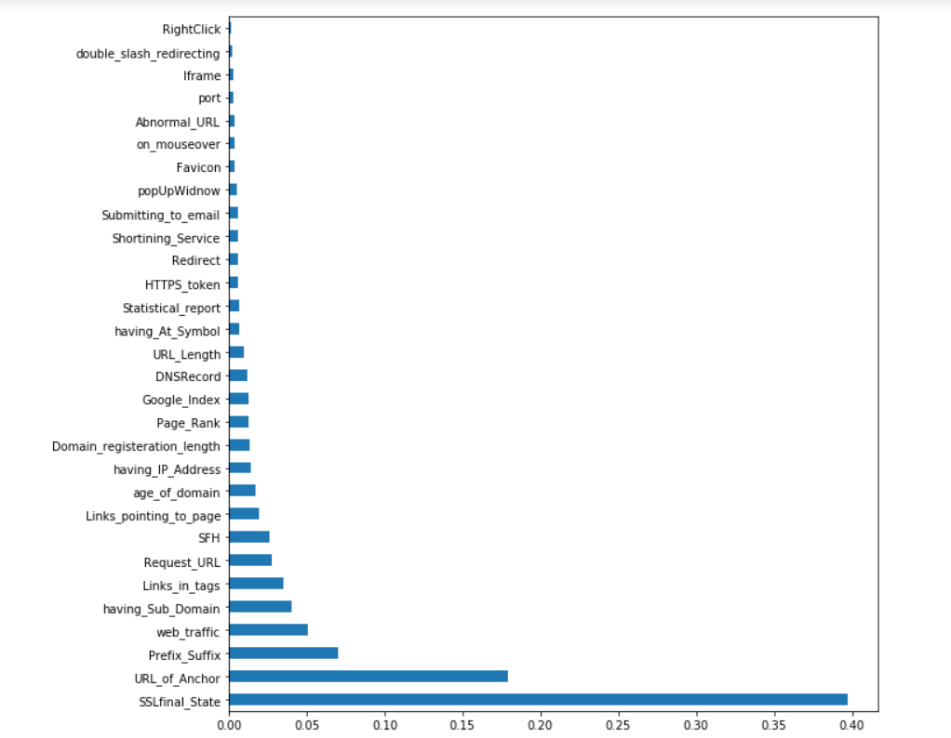
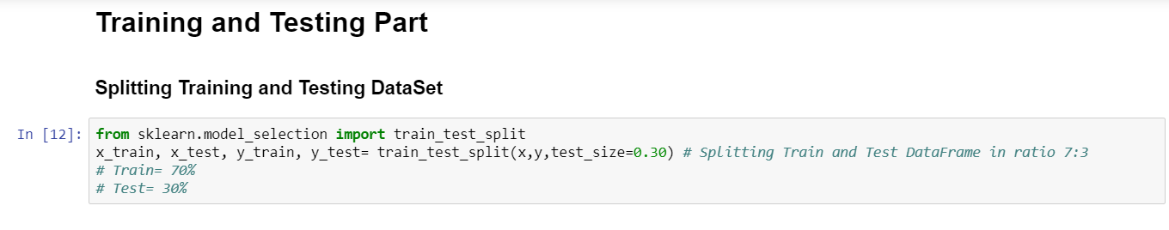

Slide 11
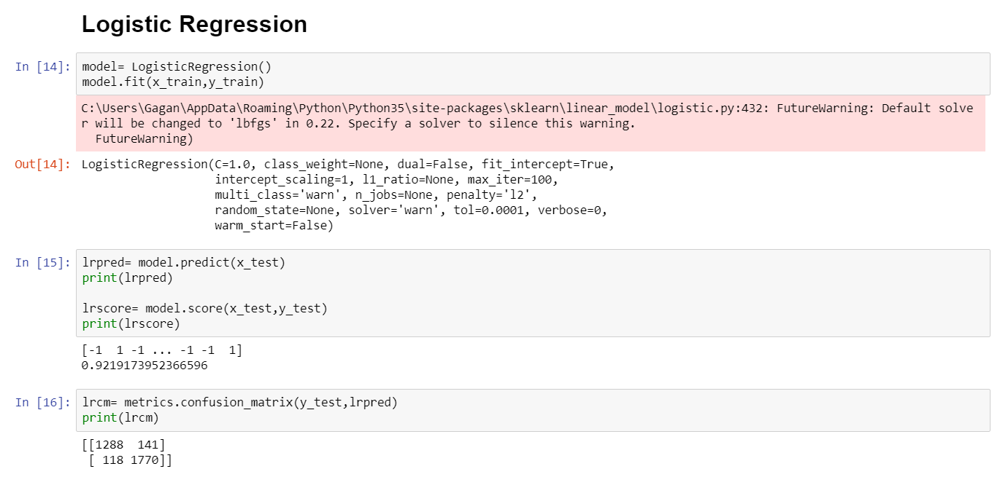
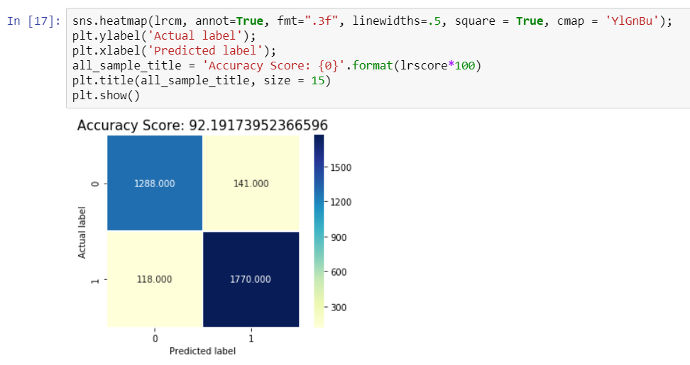

Slide 12
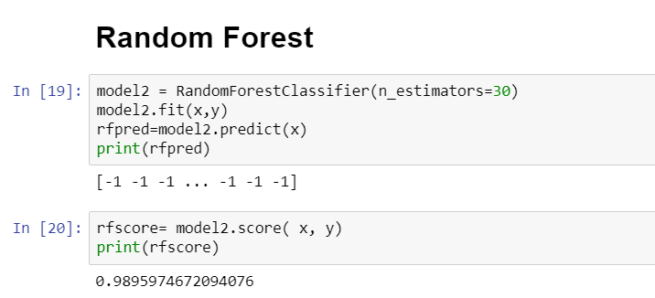
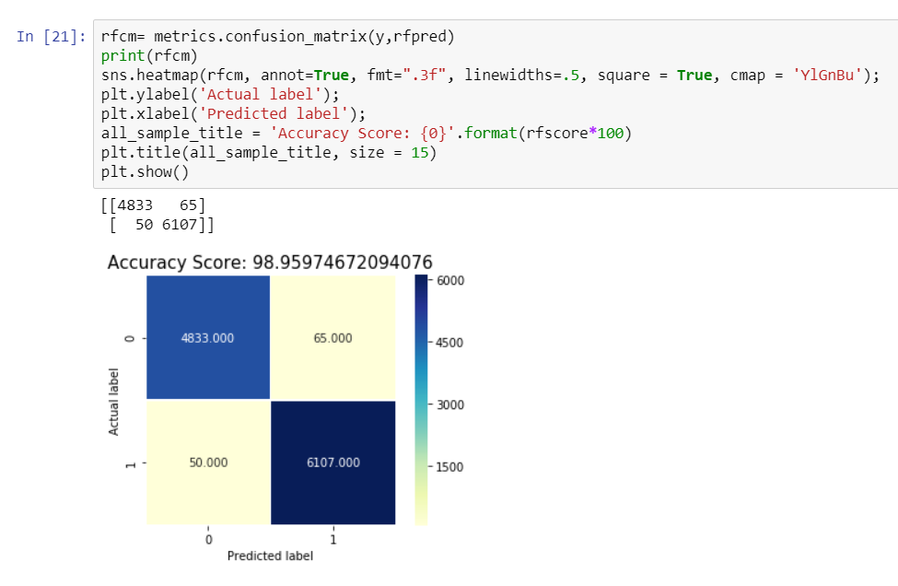

Slide 13
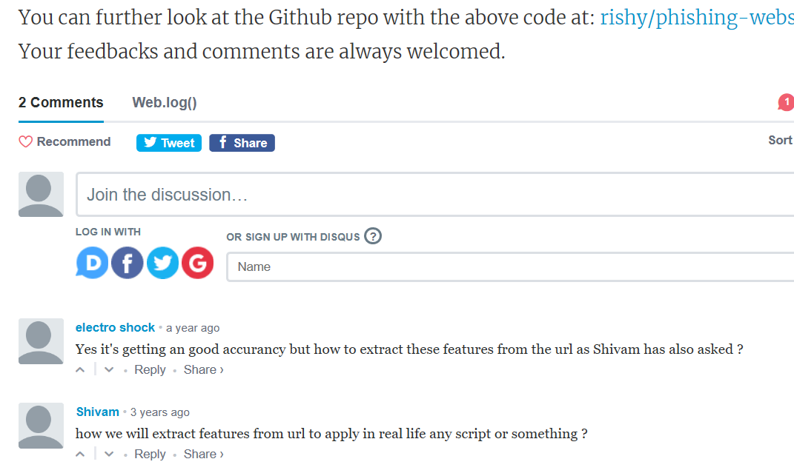
The Challenge….

Slide 14
THANK YOU

